Slide 1


Big Data Project Report
Team 17: Osama Orabi, Hamza Shafee Aldaghstany, Hadi Salloum, Yazan Alnakri
Date: May 7, 2025
Notes:
‹#›

Slide 2

Table of Contents
Introduction
Data & Pipeline
Project overview and goals
Dataset details and architecture
Analysis & Modeling
Presentation & Conclusion
Insights and machine learning
Results and team contributions
Notes:
‹#›

Slide 3

Introduction
Project goal: To help businesses in the travel domain with optimizing their profit.
Notes:
‹#›

Slide 4
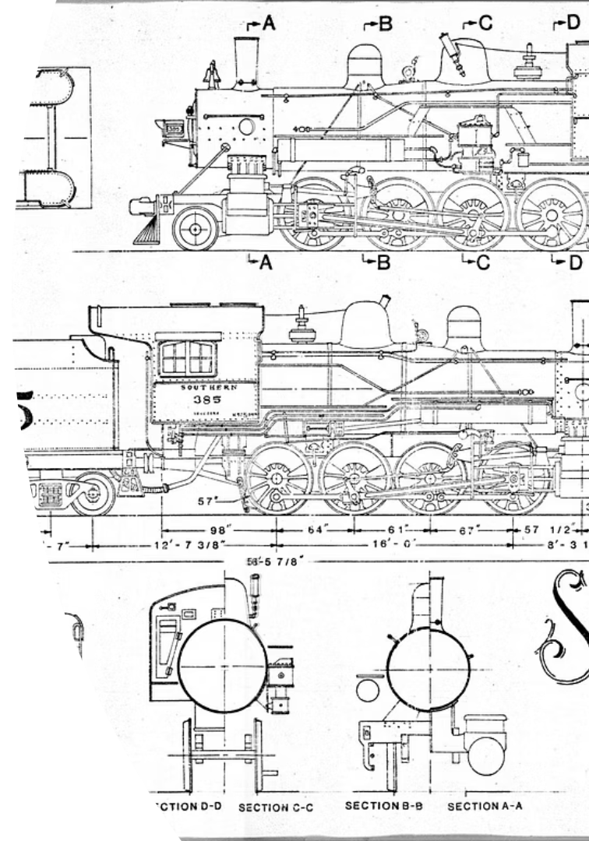
Project Objectives
Data Ingestion
Use PostgreSQL, Hive, HDFS via Sqoop for scalable storage.
Data Analysis
Explore data and generate reports on origins and prices.
Machine Learning
Train model to predict ticket prices.
Presentation
Interactive dashboard with Streamlit.
Notes:
‹#›

Slide 5

Data Characteristics
Missing Values
Time Span
Price, duration, and categories incomplete.
Data covers years 2015 to 2020.
Notes:
‹#›

Slide 6



Data Preparation
Step 1
Calculate median prices by origin, destination, vehicle type.
Step 2
Fill missing price and duration; assign default categories.
Notes:
‹#›

Slide 7
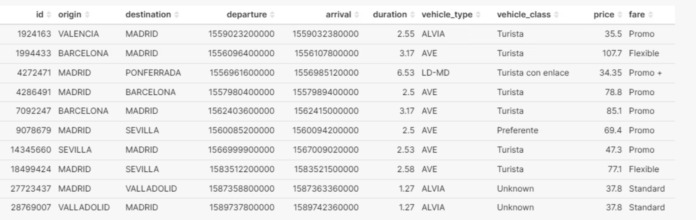
Choice of compression method and Format
We chose the compression method Snappy as it optimizes for faster reads (it considers multiple reads per one write operation)
Regarding the format we utlized the AVRO format as we consider the usage of all columns together in the next phases, unlike the parquet format which considers a subset of the features to be used.
Notes:
‹#›

Slide 8
Hive Table Creation & Optimization
Table Types
Benefits
External AVRO table (unpartitioned)
Improved query performance via partitioning and bucketing.
Partitioned by origin
Bucketed by id
Notes:
‹#›

Slide 9

Data Analysis Findings
Top Origins
Madrid, Barcelona, and others lead ticket sales.
Seasonal Trends
More demand during some periods of the year (summer mainly)
Ticket Classes
Standard most common; Preferente highest average price.
Revenue
Approximately €180M from 500K tickets sold.
Notes:
‹#›

Slide 10
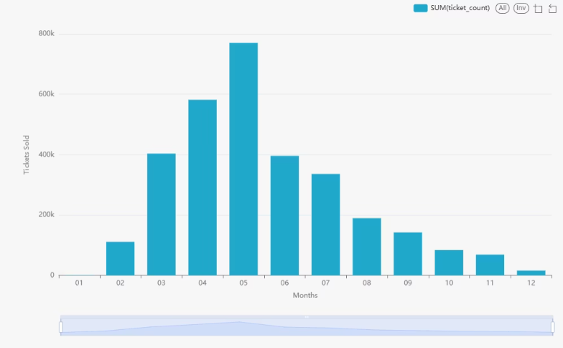
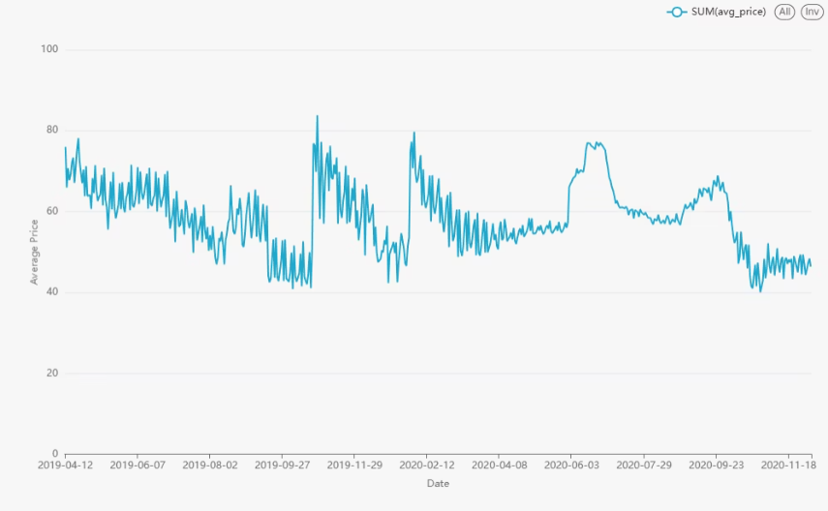
Seasonal Trends
Notes:
‹#›

Slide 11
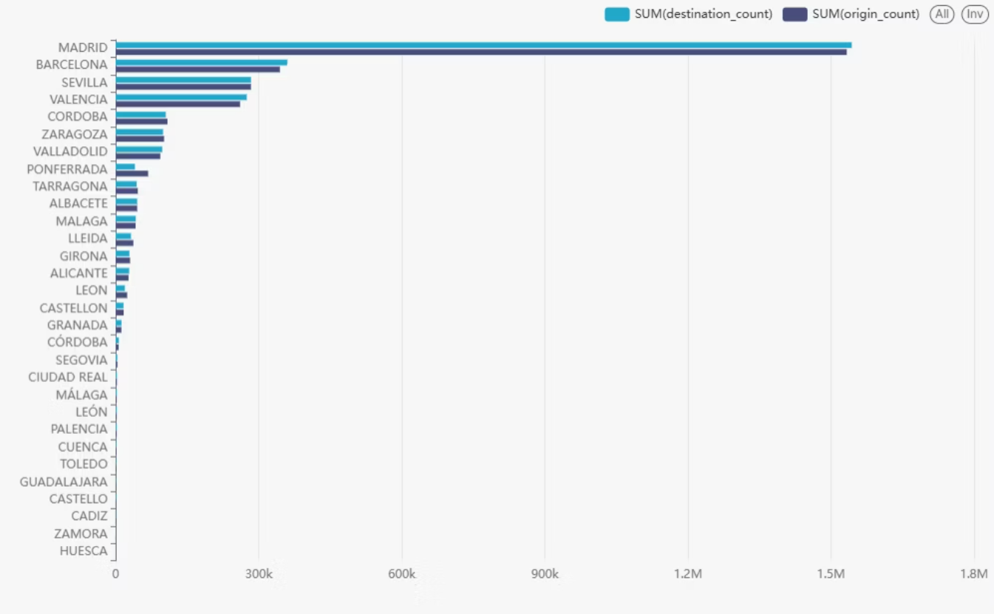
Top origins
Notes:
‹#›

Slide 12
Feature Engineering and Preprocessing Pipeline
Handling Numerical Data
Managing Categorical Variables
Temporal Feature Engineering
Missing Value Treatment
Imputation
Granular Decomposition
Normalization
Encoding Approaches
Periodic Encoding
Feature Vectorization
Dimensionality Reduction
Notes:
‹#›

Slide 13
Model Training and Evaluation Framework
Linear Regression Models: Includes Standard and Polynomial regression capturing linear and non-linear relationships.
Polynomial Regression: Employs quadratic feature expansion for complex interactions.
Decision Tree Regressor: Processes indexed features, uses non-parametric modeling and built-in feature selection.
Notes:
‹#›

Slide 14
Model Training and Evaluation Framework
Model
Tuned Parameters
Search Values
Optimal Values
R2 Score
RMSE
Linear Regression (model1)
regParam (L2)
[0.1, 0.3, 0.5]
0.1
0.826
9.93
elasticNetParam (L1 ratio)
[0.5, 0.8, 1.0]
0.5
Polynomial Regression (model2)
regParam
[0.01, 0.1, 0.3]
0.01
0.831
9.80
elasticNetParam
[0.0, 0.5, 1.0]
0.0
Decision Tree Regressor (model3)
maxDepth
[3,5,7]
7
0.850
9.22
minInstancesPerNode
[5,10,15]
5
Notes:
‹#›

Slide 15
Model Price Prediction Samples
price
prediction
10.0
14.21575749007113
10.6
11.089208400666209
100.0
99.0644406958086
100.1
100.26894242175479
100.2
92.01393325594782
100.4
78.19864523226393
100.41
78.25489714964806
100.8
93.54851159810144
101.5
67.77842565860595
101.52
78.25489714964806
Notes:
‹#›

Slide 16
Models Evaluation
model
metric
value
model1
R2
0.825580168589796
model1
RMSE
9.935109745508981
model2
R2
0.8281047472589788
model2
RMSE
9.862946537901887
model3
R2
0.8427817149678727
model3
RMSE
9.432488076769712
Notes:
‹#›

Slide 17
Issues Faced and Solutions
Data Quality Issues
Resources issue
Missing and inconsistent data impacted model accuracy.
We have utilized a a simple algorithm for us to be able to make more tests and focus on optimization instead of architecture.
Implemented thorough data cleaning and imputation methods.
Notes:
‹#›

Slide 18
Conclusions
Our work presents a proof of concept of our ability to create scalable big data projects. We should mention that we have learned the strengths and weakness for the initial frameworks that we utilized and this can guide us in future projects for choosing our stack depending on the requirements.
Thank you.
Notes:
‹#›

